Slide 1
Parent & Community Voice
LRSD Board Meeting Aug 24, 2021
By Joy Onsychak

Slide 2
For consideration
Diversity & Inclusion – Policies, Violations
Privacy of Health Information – Regulations, Policies, potential violations
Informed Consent
Risk & Liability

Slide 3
Context / About Me/ My bias

Slide 4
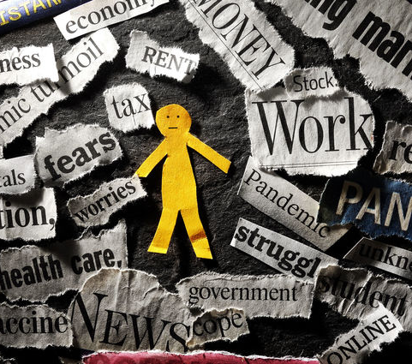
Trauma Too much too fast, and for too long. No way out Choices over body taken away

Slide 5
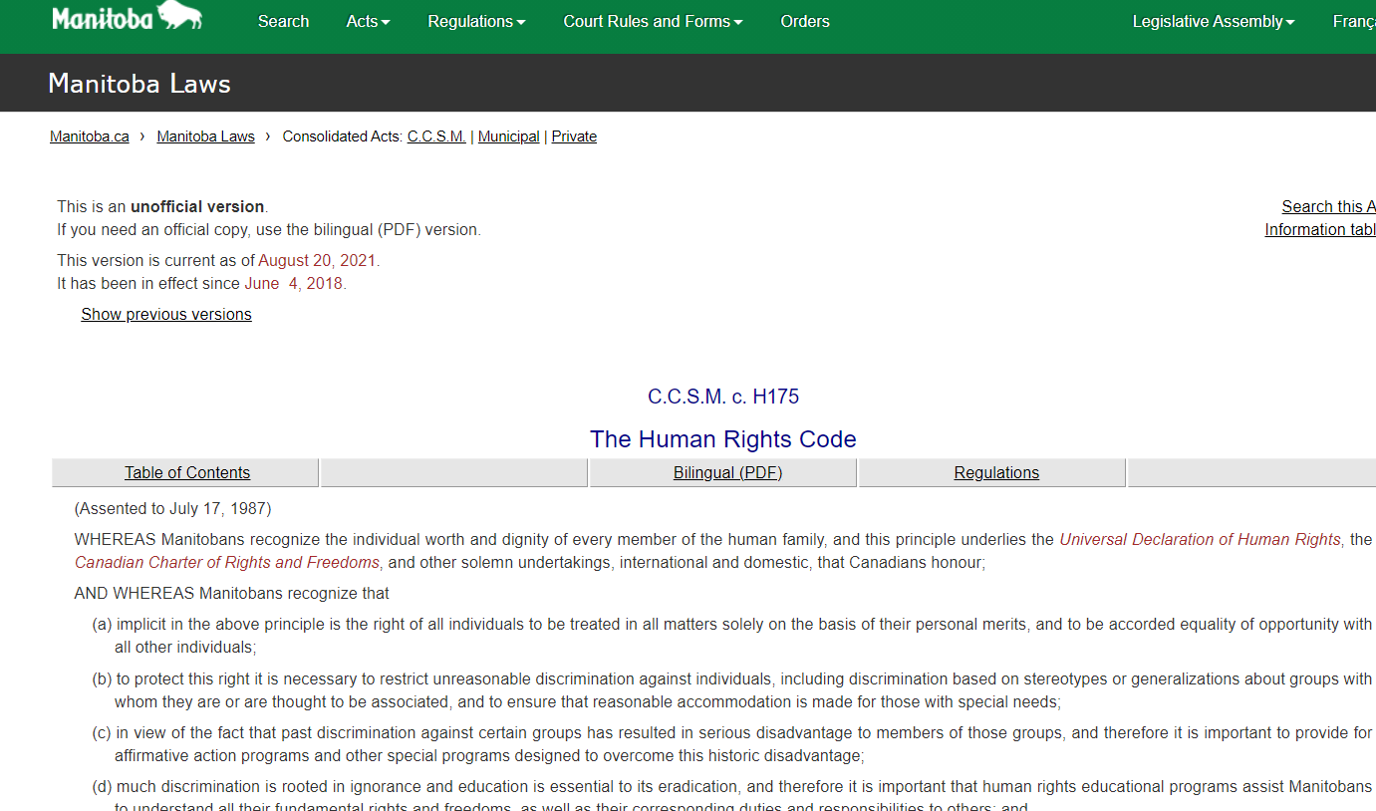
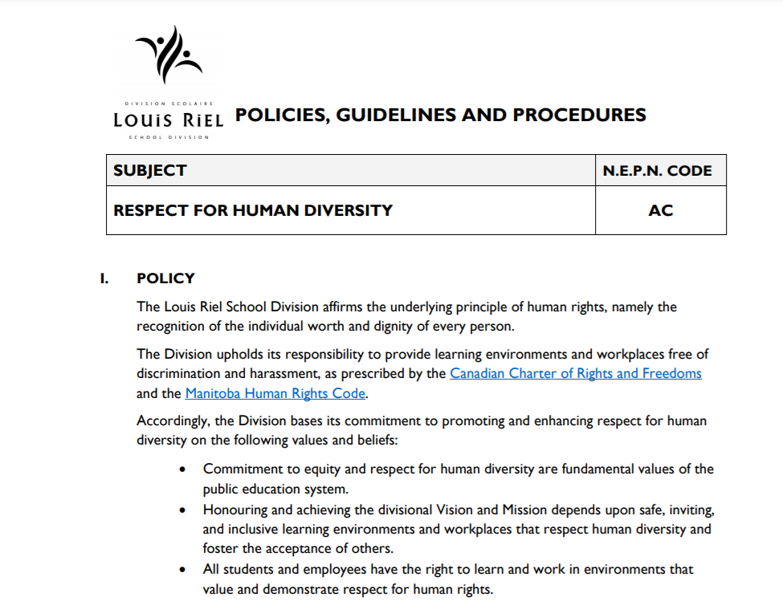
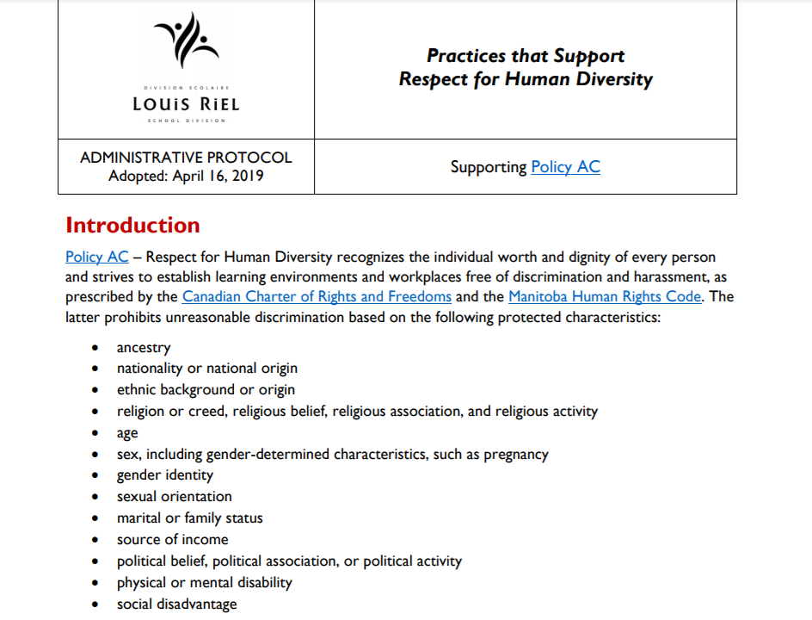
Respect for Human Diversity
MB Human Rights Code
‘Creed’
‘To provide safe, caring and inclusive learning environments and workplaces’
demonstrate respect for human diversity and human rights.
‘Bullying & Intimidation’
‘Coercion, intimidation, pressure’

Slide 6
Add to LRSD policies & procedures
Coersion (source: Black’s law) Compulsion; force; duress. It may be either actual, (physical force) to compel one to do an act against their will, or implied, where the relation of the parties is such that one is under subjection to the other, and is thereby constrained to do what their free will would refuse.
Duress (Source: Black’s law) “Every individual should have the autonomy to make decisions for themselves.” “When someone threatens another person with the intention of getting them to do something they normally wouldn’t have done, it can possibly be considered “duress.”
Segregation (Source: Black’s law) “the act of separating such as in races in a school or other public places.”

Slide 7
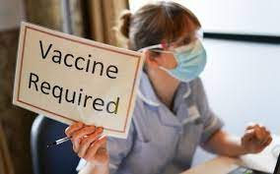
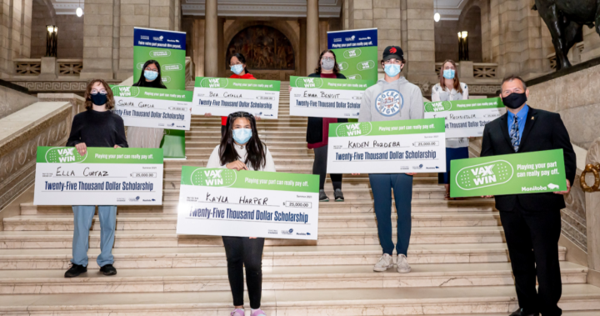
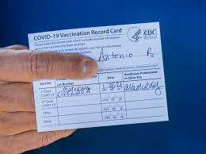
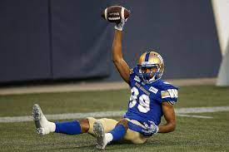

Slide 8
“If you all want a grad next year, you’d better get your vaccine as soon as possible.”

Slide 9
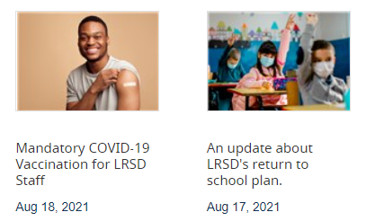
LRSD Coercion of Staff & Students to work and attend public school.
medical-grade masks
voluntary disclosure of vaccination status
potential requiring COVID-19 vaccination for eligible students and staff
use of rapid testing kits in schools for the unvaccinated

Slide 10
Privacy of Health Information
https://web2.gov.mb.ca/laws/statutes/ccsm/p033-5e.php
13 (1) A trustee shall not collect personal health information about an individual unless
(a) the information is collected for a lawful purpose connected with a function or activity of the trustee; and
(b) the collection of the information is necessary for that purpose.

Slide 11
What is Herd Immunity & Do we have it?
Dr. Joss Reimer ..."herd immunity" (a colloquial term used to describe when a large portion of a community becomes immune to an infection via vaccination or previous infection, making person-to-person transmission of disease unlikely)’
WRHA April 26, 2021 titled ‘COVID-19 Vaccinations are our quickest route back to normal’. https://wrha.mb.ca/2021/04/26/covid-19-vaccinations-are-our-quickest-route-back-to-normal/
Dr. Byram W. Bridle, CND Vaccinologist
“The concept of ‘herd immunity’ means that a virus will stop spreading among a population once most of the people in that population acquire a protective immune response...”
https://www.canadiancovidcarealliance.org/wp-content/uploads/2021/06/2021-06-15-Children-and-COVID-19-Vaccines-full-guide_-FINAL.pdf (page 7&8)

Slide 12
Questions If we are 80% vaccinated, why do we need to…
Mandatory vaccinate anyone?
Collect vaccination information?
Undergo rapid testing?
Wear masks?

Slide 13
Informed Consent
Province of Manitoba Public Health Branch, Document titled ‘Informed Consent Guidelines for Immunization’ amended April 2015
https://www.gov.mb.ca/health/publichealth/cdc/protocol/consentguidelines.pdf
‘Information, comprehension and willingness to participate (voluntariness) are fundamental elements of the informed consent document. The consent should adequately convey all the information needed for the subject to understand the immunization event, in addition to being in a language understandable to the client.’
‘A client’s consent to participate must be free from coercion.’
‘Above all, the client should be able to understand the information presented in order to make an informed decision.’

Slide 14
Did you give Informed Consent?
Legal Definition of Informed Consent https://legal-dictionary.thefreedictionary.com/Informed+Consent ‘Assent to permit an occurrence, such as surgery, that is based on a complete disclosure of facts needed to make the decision intelligently, such as knowledge of the risks entailed or alternatives.’
A consent form itself is not consent
https://www.cmpa-acpm.ca/en/advice-publications/handbooks/consent-a-guide-for-canadian-physicians
‘Consideration of a consent form to be signed by the patient should not obscure the important fact that the form itself is not the "consent." The explanation given by the physician, the dialogue between physician and patient about the proposed treatment, is the all important element of the consent process. The form is simply evidentiary, written confirmation that explanations were given and the patient agreed to what was proposed. A signed consent form will be of relatively little value later if the patient can convince a court the explanations were inadequate or, worse, were not given at all.’

Slide 16
Testing, Cases, False Sense of Security/Fear & Consequences
PCR Tests
Questions;
Rapid Antigen Testing
56% False Positive
https://www.jccf.ca/manitoba-chief-microbiologist-and-laboratory-specialist-56-of-positive-cases-are-not-infectious/
-Are the tests reliable?
-How is information collected, stored, shared?
-False sense of security?
False sense of fear?
-What are the consequences?
(Missed School, Isolation, Quarantine, Segregation, mental health decline)
Recently recalled
https://worlddoctorsalliance.com/blog/innova-medical-group-recalls-unauthorized-sars-cov-2-antigen-rapid-qualitative-test-risk-false-test/

Slide 17
Concerns by Doctors, Scientists & Advocacy Groups
Physicians
Scientists
Parent Groups
https://canadahealthalliance.org/
https://doctors4covidethics.org/
https://doctors4covidethics.org/expert-evidence-regarding-comirnaty-covid-19-mrna-vaccine-for-children/)
Covid-19 Vaccines & Children – A parents Guide
https://www.canadiancovidcarealliance.org/wp-content/uploads/2021/06/2021-06-15-Children-and-COVID-19-Vaccines-full-guide_-FINAL.pdf
The Great Barrington Declaration https://gbdeclaration.org/
https://vaccinechoicecanada.com/

Slide 18
Risks & Liabilities
Risks to young people !See Dr Bridle’s information and others!
Harms caused by prolonged mask
Serious vaccine injury (short and long term) & Death
? Unknown long-term effects (sterility)
Loss of privacy of health info
Segregation, isolation
Liability Costs $$$$
Increase in case #s
Extremely high rate of recovery in children

Slide 19
We Require Alternatives
Stay home when ill – do your own contact tracing for flu symptoms.
Promote Health (Vit D, C, sunlight, exercise, nutrition, sleep, gut health, social and family connection – the majority of which is free or very low cost)
Stop mandatory, useless & harmful masking of healthy, children, particularly elementary kids.
Stop coercion, and contribution to collective trauma by giving staff and families choice.
Protect Personal Health Information & Human Rights of staff and students.
Focused protection Strategies (Great Barrington Declaration)
Halt Rollout of Vaccine Clinics in schools – until the province changes the consent process to include parents.

Slide 20
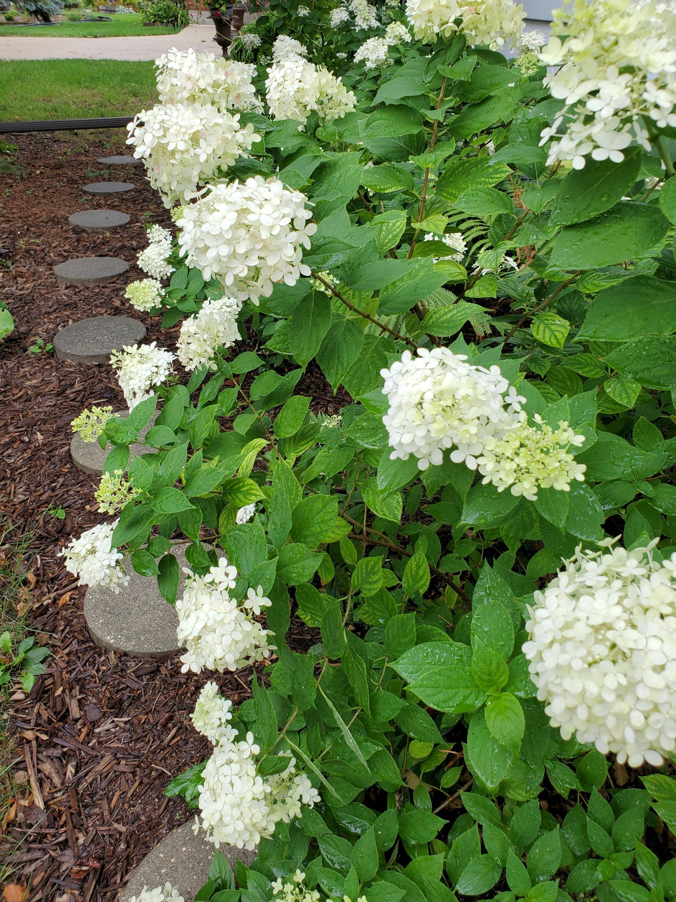
In Summary & Thank You
Corrections/More info/Contact;
joy@joysomatics.ca

